Slide 1

r
Department of Computer Applications
Robust Data-Driven Analysis for Electricity Theft
Attack-Resilient Power Grid
Review - ׀
Presentation By:
Govardhan Reddicharla
Roll No: 23691f0049
Under The Guidance of:
Dr.Srinivasan J
Assistant Professor
Department of Computer Applications

Slide 2
Contents
Introduction
Overview of the project
Problem statement
Objectives of the project
Scope of the project
Methodology
Literature survey
Existing system
Proposed system
Modules split up
Requirements
References

Slide 3
INTRODUCTION

Slide 4
Overview of the Project
This project proposes a machine learning-based solution to identify and prevent electricity theft in smart power grids.
It integrates advanced data analytics, preprocessing techniques, feature engineering, and modern classification models like Random Forest, XGBoost, SVM, and ANN.
We balance the dataset using SMOTE to improve model generalization. The best-performing model is deployed in a lightweight dashboard using Flask for real-time use.

Slide 5
Problem Statement
Electricity theft remains a significant challenge in modern smart grids, leading to billions in energy losses each year. Traditional detection methods, which depend on manual audits or fixed thresholds, often fall short in identifying complex and evolving theft patterns. Moreover, there is a clear absence of intelligent, automated systems that can dynamically and accurately analyze consumption behavior. To address these gaps, this project proposes a robust, scalable, and data-driven framework that leverages machine learning and real-time dashboards for effective electricity theft detection.

Slide 6
Objectives of the Project
Detect electricity theft using ML models with a focus on high accuracy and recall for theft cases.
Handle imbalanced data using SMOTE to ensure fair detection of minority class (theft cases).
Design a lightweight, user-friendly dashboard for real-time theft monitoring and reporting.
Compare and evaluate multiple classifiers (Decision Tree, Random Forest, SVM, XGBoost, ANN) to determine the best-performing model.
To detect electricity theft accurately using machine learning techniques.
To reduce manual effort by automating the theft detection process.
To provide real-time monitoring and visualization through user-friendly dashboards.
Project Goals:

Slide 7
Methodology Adopted
Data Collection: Load consumption data from smart meters (real or simulated datasets).
Data Preprocessing: Clean and transform data using label encoding, normalization, outlier handling.
Feature Extraction: Identify key attributes impacting theft (usage variation, time, load).
Model Training: Train models (RF, DT, SVM, XGBoost, ANN) with hyperparameter tuning and cross-validation.
Evaluation: Use metrics like accuracy, precision, recall, F1-score; focus on theft recall.
Dashboard: Deploy the best model in a Flask app for live detection and alerts.

Slide 8
Literature Survey
Background Study: Electricity theft causes severe revenue loss; needs robust automated detection.
Review of Existing System: Lack precision, limited to manual/threshold-based methods.
Research papers and Findings: ML models (RF, XGBoost) improve detection but face class imbalance and generalization issues.
Gaps in the Existing Systems: Imbalanced datasets, poor performance on minority class, no integrated monitoring.
Solution to the Gap: Data balancing (SMOTE), tuned ML models, real-time dashboard.

Slide 9
S. No | Title | Authors | Journal/ Year | Methods | Merits | Limitations
1 | CatBoost-based supervised machine learning framework for electricity theft detection | S. Hussain et al. | Energy Reports, 2021 | CatBoost, Feature Engineering, Outlier Detection | Fast training, Strong handling of categorical features | Requires high-quality feature selection
2 | An adaptive synthesis to handle imbalanced Big Data with deep Siamese network for electricity theft detection in smart grids | N. Javaid, N. Jan, M. Javed | Journal of Parallel and Distributed Computing, 2021 | Deep Siamese Networks, Data Balancing Techniques | Improved handling of imbalanced data | Requires expert knowledge for parameter tuning
3 | Hybrid deep neural networks for detection of non-technical losses in electricity smart meters | M.-M. Buzau, J. Tejedor-Aguilera, P. Cruz-Romero, A. Gómez-Expósito | IEEE Transactions on Power Systems, Mar. 2020 | Hybrid Deep Neural Networks (DNN), Convolutional Neural Networks (CNN), Autoencoders | Robust feature extraction, High accuracy in complex data patterns | Requires large computational resources, Risk of overfitting
4 | Robust Big Data analytics for electricity price forecasting in the smart grid | K. Wang, C. Xu, Y. Zhang, S. Guo, A. Y. Zomaya | IEEE Transactions on Big Data, Mar. 2019 | Big Data Analytics, Machine Learning Models, Time Series Analysis | Efficient handling of large data volumes, Improved prediction accuracy | High implementation cost, Requires extensive data labeling
5 | Detection of non-technical losses using smart meter data and supervised learning | M. M. Buzau, J. Tejedor-Aguilera, P. Cruz-Romero, A. Gómez-Expósito | IEEE Transactions on Smart Grid, May 2019 | Supervised Learning, Feature Engineering, Data Clustering | High detection precision, Efficient for small-scale grids | Performance degrades with incomplete data

Slide 10
Existing System
Manual Inspection: Relies on human meter readers; time-consuming and prone to error.
Rule-Based Alerts: Uses fixed thresholds to detect anomalies—ineffective for complex theft.
Basic Machine Learning: Earlier models often ignore class imbalance and feature importance.
No Visualization: Lack of dashboards or interpretability in existing tools.
Limitations:
Limited Accuracy: High false negatives due to basic or unoptimized models.
Labor Intensive: Manual audits delay detection and increase costs.
Outdated Techniques: Cannot adapt to evolving theft strategies.
No Real-Time Capabilities: Detection and response are delayed, increasing losses

Slide 11
Proposed System
Smart ML-Based Detection: Automates theft detection with higher accuracy.
Balanced Data Handling: Applies SMOTE to mitigate class imbalance, boosting theft recall.
Modular Pipeline: Covers preprocessing, training, evaluation, and deployment.
Interactive Dashboard: Provides real-time alerts and visual insights via Flask app.
Advantages:
Higher Accuracy: XGBoost and RF provide improved performance with balanced data.
Real-Time Monitoring: Flask dashboard enables quick decisions and alerts.
Scalability: Easily expandable for larger datasets and real-world deployment.
Cost Efficiency: Reduces human labor, loss, and operational expenses.

Slide 12
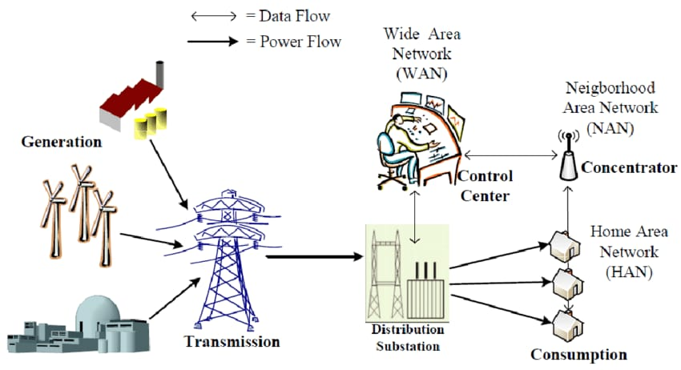

Slide 13
Modules Split-Up
1.User Input – Collects data or commands from the user to initiate the theft detection process.
2.Data Collection – Gathers electricity consumption data from smart meters or datasets.
3.Data Preprocessing – Cleans and transforms raw data to ensure consistency and quality.
4.Feature Extraction – Identifies key patterns and attributes that influence theft detection.
5.Model Training – Uses machine learning algorithms to learn from historical data.
6.Evaluation – Assesses model performance using metrics like accuracy and recall.
7.Dashboard – Visualizes results and provides real-time monitoring of theft predictions.
8.Output – Displays final theft detection results or alerts based on analysis.

Slide 14
Requirements
Software Requirements:
Operating System | Windows 11 or Above
Server | Flask (for interface/dashboard)
Programming | Python 3.7 or Above
FrontEnd | HTML , CSS , Bootstrap
IDE | VS Code
Database | MySQL
Hardware Requirements:
System | Intel Core i5 or Higher
Hard Disk | 512 GB (SSD Preferred)
RAM | 8 GB Minimum

Slide 15
References
1. A Comprehensive Review on Electricity Theft Detection using ML Techniques – IJERT, 2023.
2. Smart Meter Based Frameworks for Theft Detection – Elsevier Energy Reports, 2022.
3. Comparative Study on ML Classifiers for Power Theft – IEEE Access, 2022.
4. Anomaly Detection Using XGBoost for Power Consumption – Springer, 2021.
5. Real-time Electricity Theft Monitoring via Smart Grids – IEEE IoT Journal, 2023.

Slide 16

THANK YOU

